Slide 1
Income vs. Food Access
in San Francisco
Tammy Cronin | Angelica Ramos | Cristina Shary

Slide 2
Research Questions
Does income level impact access to fresh foods in San Francisco?
How does fresh food access in San Francisco compare to access across California?
How does fresh food access in San Francisco compare to national access to fresh foods?
What percentage of the population has low access to fresh foods?
Notes:
Our team was interested in exploring how income level affects access to fresh foods.
We decided to look at San Francisco a case study for exploration. Specifically:
- Does income level impact access to fresh foods in San Francisco?
- How does fresh food access in San Francisco compare to access across California?
- How does fresh food access in San Francisco compare to access across national data?
- What percentage of the population has low access to fresh foods?

Slide 3
Hypothesis
Our hypothesis is that accessibility to fresh foods decreases as the level of income decreases
Notes:
Our hypothesis was that the access to fresh foods would decrease the lower the income level

Slide 4
Definitions
Food Access
Freshness of food
Low-Income
What constitutes food accessibility? What qualifies as low-income?
Notes:
We found a data set on food access from the U.S. Department of Agriculture, Economic Research Services.
The Food Access Research Atlas provides indicators and data for measuring access to fresh foods.
A key indicator for access to fresh foods is the proximity to a full-service grocery store.

Slide 5
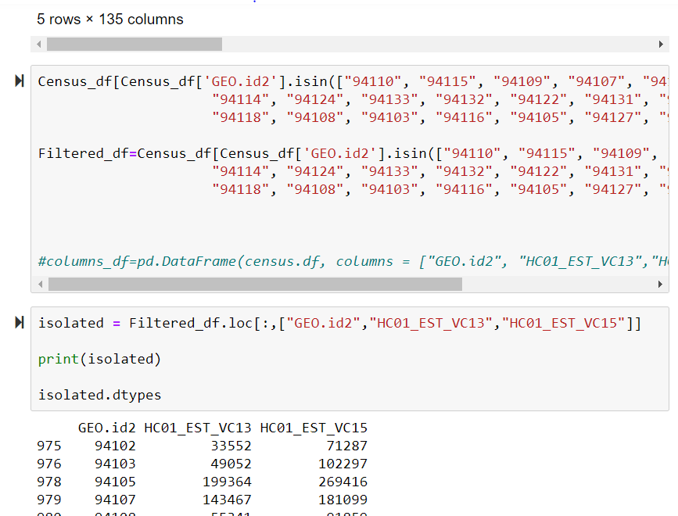
Exploration

Slide 6
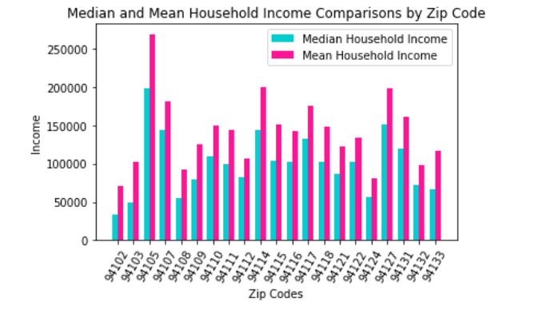

Slide 7
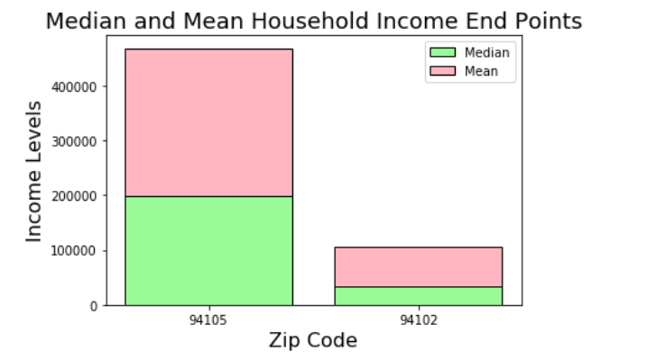

Slide 8
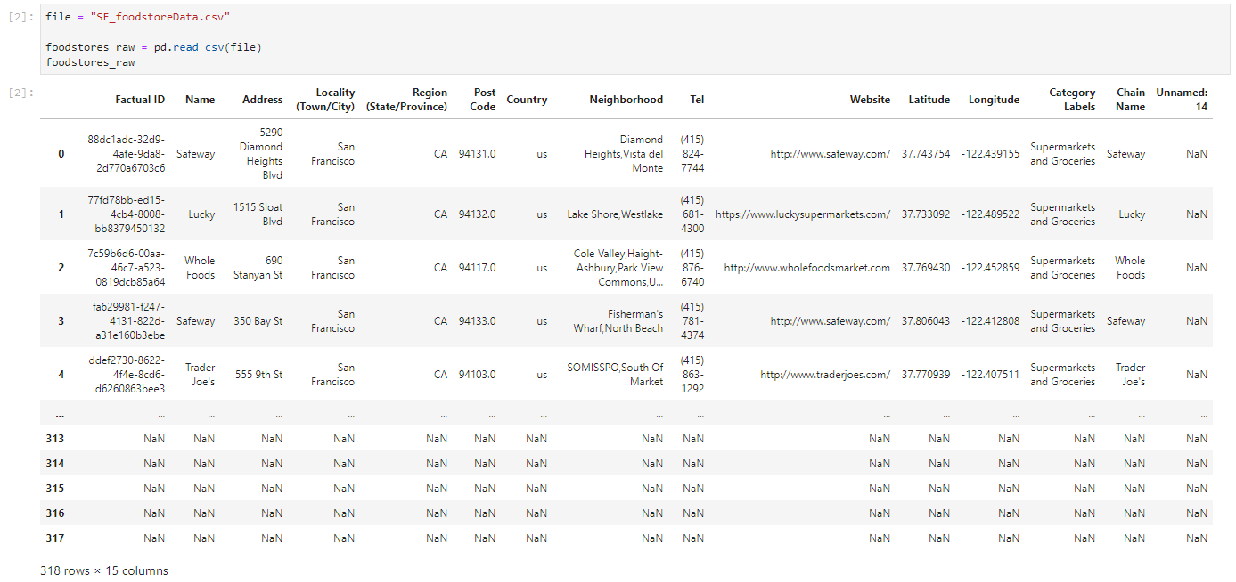
Exploration
Source: https://places.factual.com/data/t/places

Slide 9
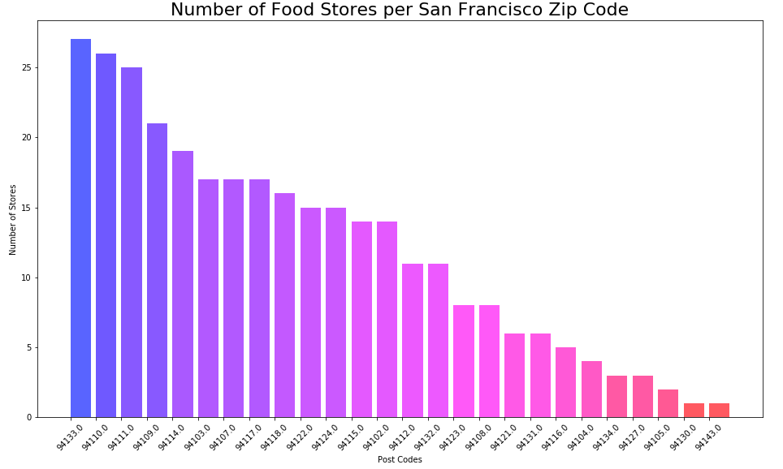

Slide 10
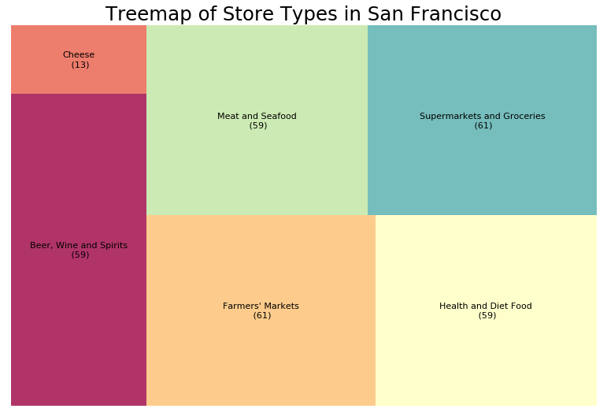

Slide 11
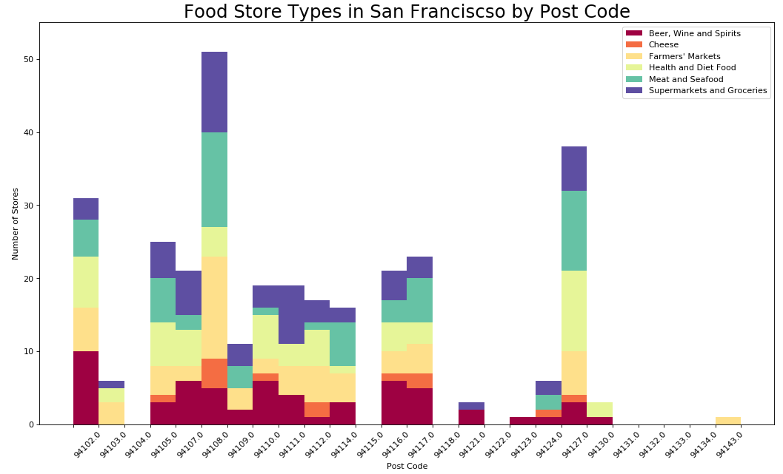

Slide 13
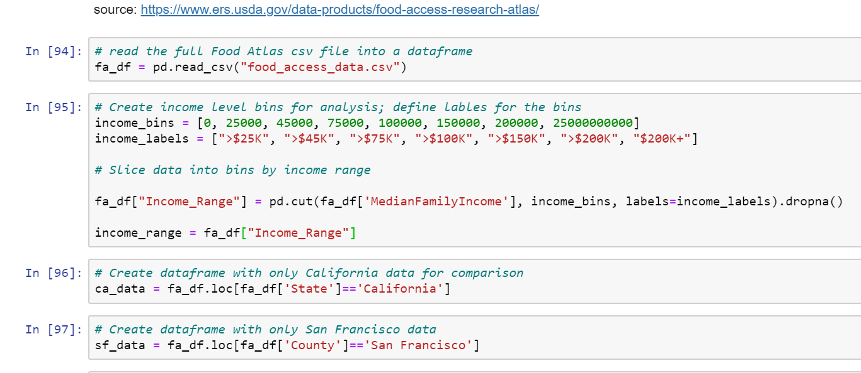
Exploration
Defining boundaries
Division by postcode

Slide 14
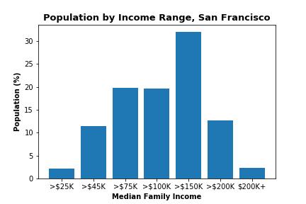
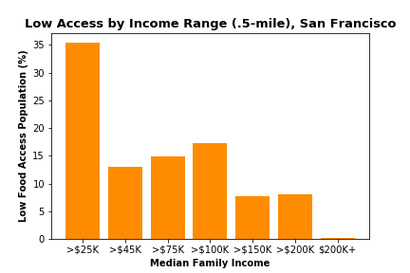
San Francisco data alone appears to support our hypothesis

Slide 15
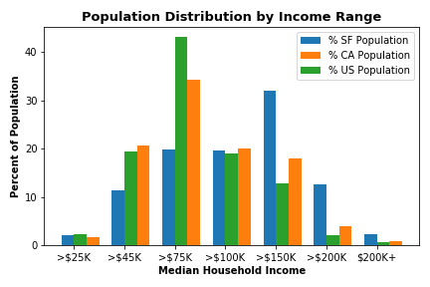
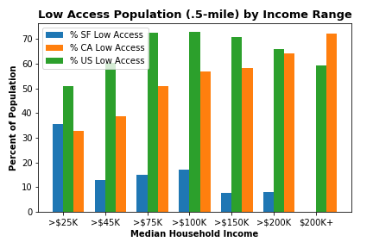
Compared to US and CA, SF income by population is similar, though quite different for low access population

Slide 16
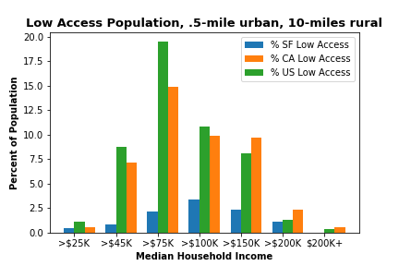
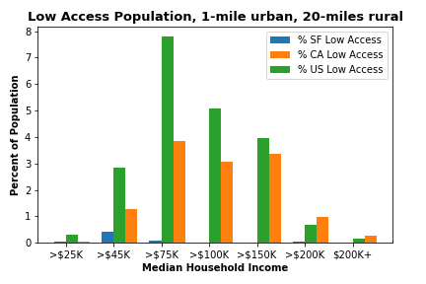
Food access appears to decrease by income level considering CA/US data

Slide 17
Conclusions
Hypothesis not supported by data outside of San Francisco
Access to fresh foods is influenced by geospatial location, driving distance, vehicle access, et al
Analysis could be enriched with geospatial mapping
Notes:
Lessons learning -
It’s easy to get bogged down in a rabbit-hole of analysis and building charts to support analysis.
It’s important to be precise and focused on data to be analyzed and information needed
As a wise sage once said, be really clear on this before writing any code. A lot of time can be wasted writing and revising code!

